Slide 1
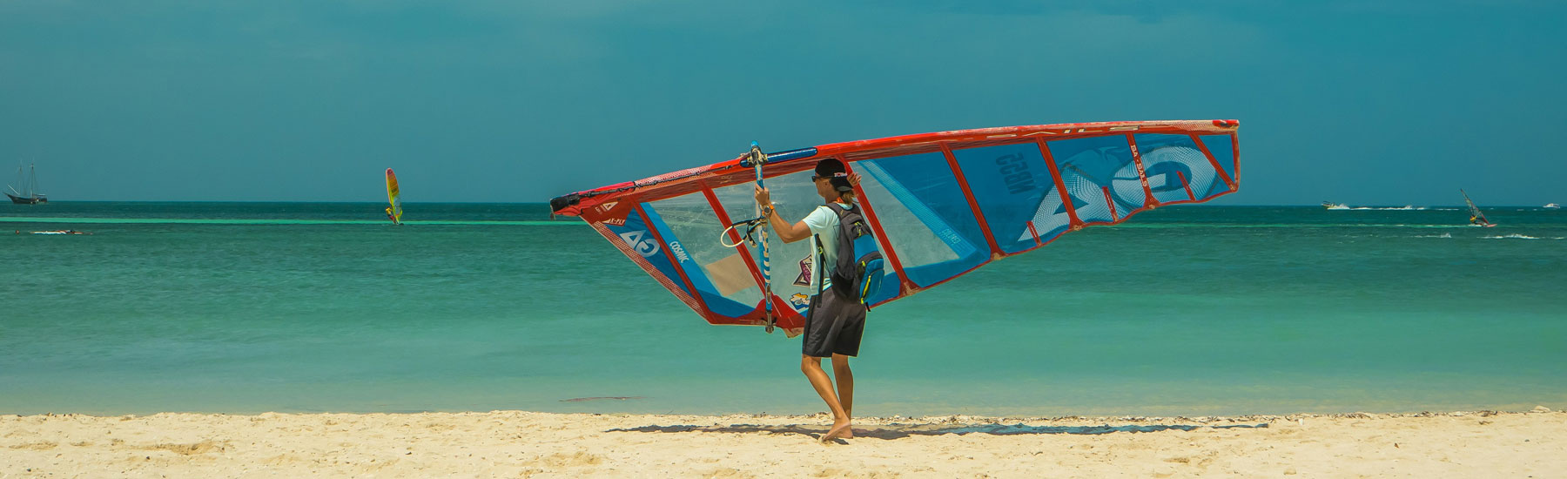

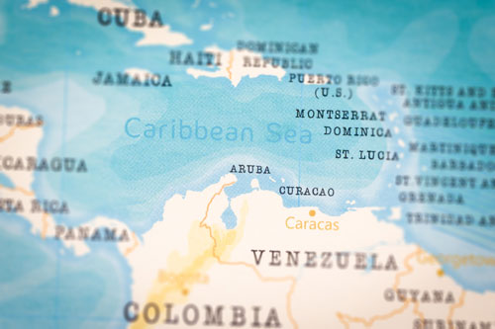
Meetings & events Aruba
Electricity
is 127 volts at 60 Hz
Unique in Aruba: White sandy beaches and Aloe Vera farms
Seasons:
High: Dec-Apr; Shoulder: May-Aug; Low: Sept-Nov
Official Languages: Dutch and Papiamento.
Local time
UTC -4.00 hours
Currency
Aruban Florin (AWG), with U.S. dollars widely accepted.
Average Temperature: Warm and sunny year-round, averaging 27-30°C (80-86°F).
Passport Requirements: A passport valid for at least the duration of stay.
International
Queen Beatrix International Airport.
Important numbers
Country Code: +297
Ambulance: 911
Police: 100
DMC Professionals for DMC services worldwide

